Slide 1


3 December, 2022
Sponsored and Supported by:

Slide 2
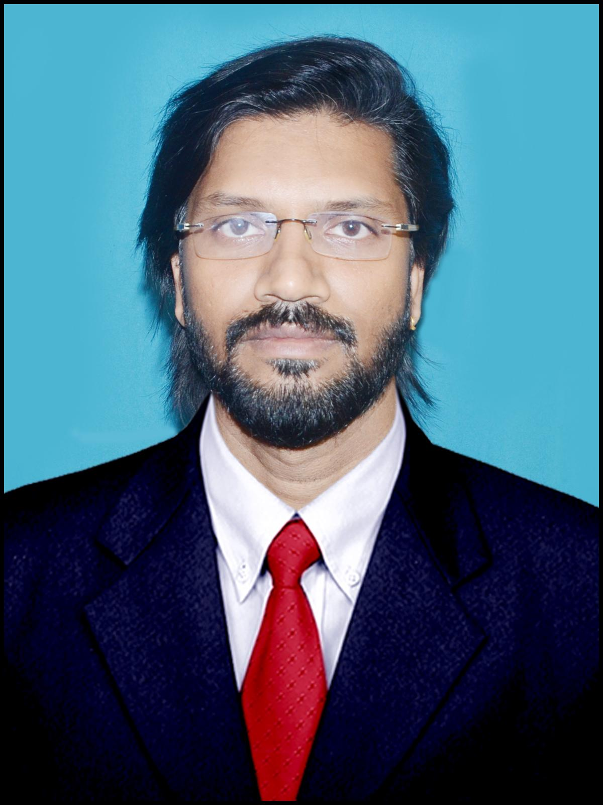
Session No. 5
linkedin.com/in/sujithkumarps
SPEAKERS PANEL
Business automations using Power Platform + Teams + Graph API
11:50 AM – 12:35PM
SujithKumar P Sukumaran
Director Delivery Expert at CGI

Slide 3




Our Team
Power Apps
Teams
Graph API
3

Slide 4
Demo’s
01
02
03
Integration
Subscription
Real World Scenario
Integrate Graph API with power platform and Teams
Subscribe To-do Tasks creation and sent notification to Teams
Teams with Virtual Reality Site integration
4

Slide 5
Demo 1: High level Steps
02
04
01
Create Custom connector
03
Integrate Canvas app to Teams
Register App
Create Canvas App
5

Slide 6
Demo 2: High level Steps
02
04
01
Subscribe for Notifications
03
Trigger Flow to send message to Teams
Create & Register App
Receive Notifications
6

Slide 7
Demo 3
02
04
01
Create Azure Functions for integration
03
Integrate teams messages using Graph API for chat facility
Create Virtual Reality App
Integrate Teams Meetings/Presence using Graph API
7

Slide 8








A Big Thank You to all the Sponsors!
Diamond:
Learning Partner:
Platinum:
Gold:

Slide 9

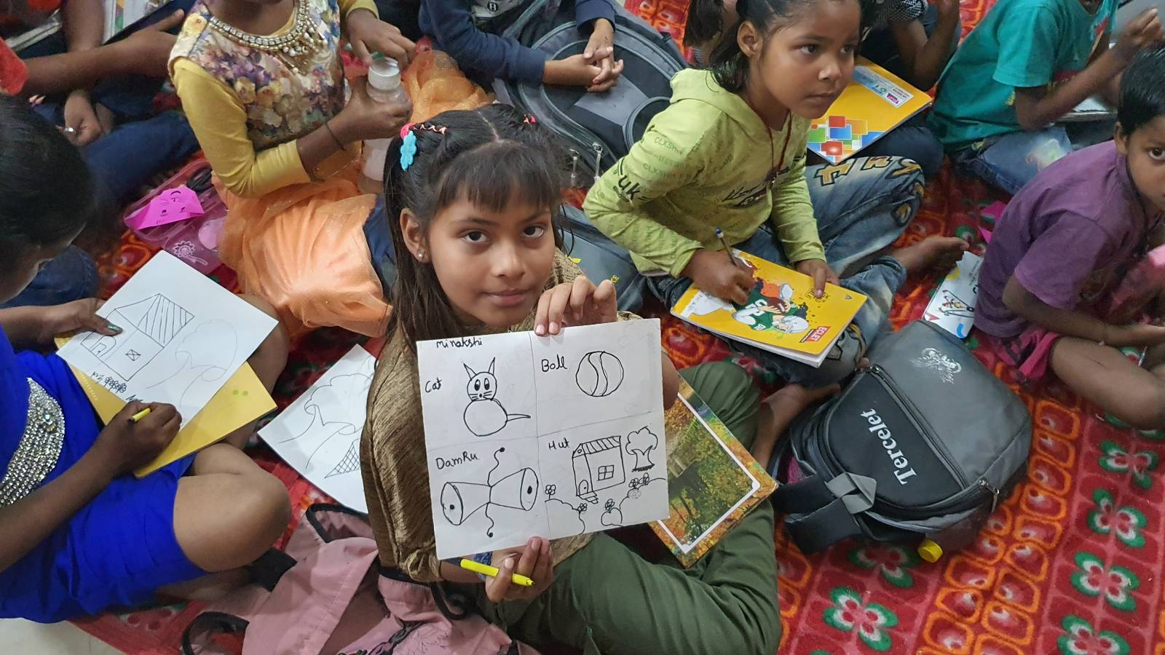
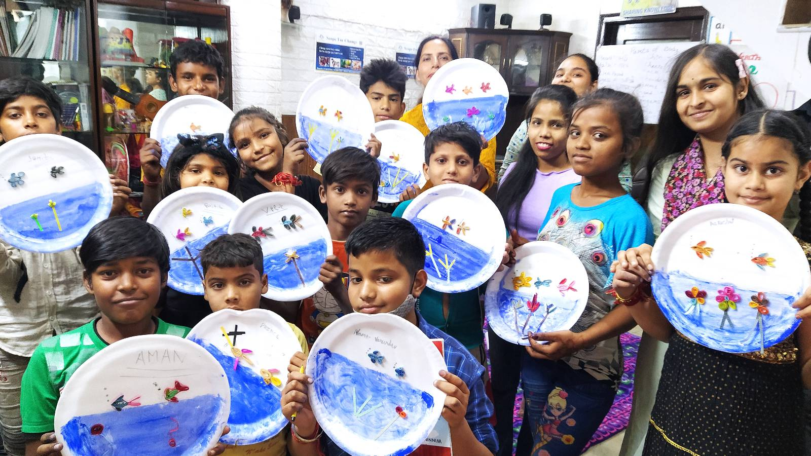

SUPPORT A CAUSE
“Giving is Receiving”
Support ‘Scope for Change’ to create more impact and touch the lives of more underprivileged students.

Slide 10

linkedin.com/in/sujithkumarps
It’s Time For Q&A
10

